Slide 1
Java Comments
Comments can be used to explain Java code, and to make it more readable. It can also be used to prevent execution when testing alternative code.
Single-line Comments
Single-line comments start with two forward slashes (//).
Any text between // and the end of the line is ignored by Java (will not be executed).
This example uses a single-line comment before a line of code:
// This is a comment
System.out.println("Hello World");

Slide 2
Java Multi-line Comments
Java Multi-line Comments
Multi-line comments start with /* and ends with */.
Any text between /* and */ will be ignored by Java.
This example uses a multi-line comment (a comment block) to explain the code:
Example
/* The code below will print the words Hello World
to the screen, and it is amazing */
System.out.println("Hello World");

Slide 3
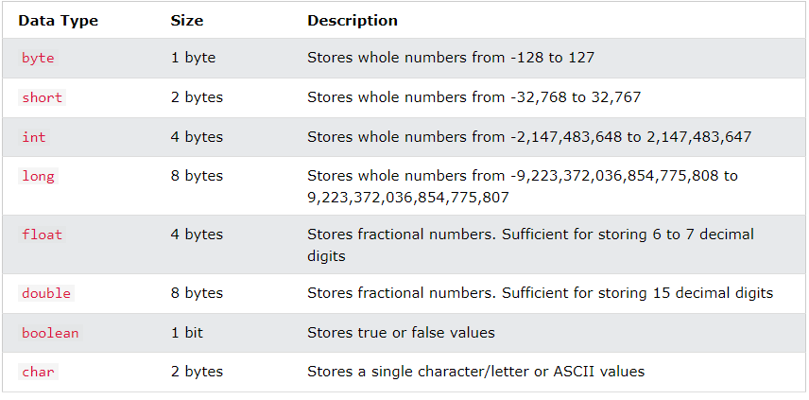
Primitive Data Types:
A primitive data type specifies the size and type of variable values, and it has no additional methods.
There are eight primitive data types in Java:

Slide 4
Non-Primitive Data Types:
Non-primitive data types are called reference types because they refer to objects.
The main difference between primitive and non-primitive data types are:
Primitive types are predefined (already defined) in Java. Non-primitive types are created by the programmer and is not defined by Java (except for String).
Non-primitive types can be used to call methods to perform certain operations, while primitive types cannot.
A primitive type always has a value, while non-primitive types can be null.
A primitive type starts with a lowercase letter, while non-primitive types starts with an uppercase letter.
Examples of non-primitive types are Strings, Arrays, Classes, Interface, etc

Slide 5
Java Variables
Variables are containers that store information that can be manipulated and referenced later by the programmer within the code. Java variables have a data type associated with them which can tell us about the size and layout of the variable’s memory.
Rules to Declare a Variable
A variable name can consist of Capital letters A-Z, lowercase letters a-z digits 0-9, and two special characters such as _ underscore and $ dollar sign.
The first character must not be a digit.
Blank spaces cannot be used in variable names.
Java keywords cannot be used as variable names.
Variable names are case-sensitive.
There is no limit on the length of a variable name but by convention, it should be between 4 to 15 chars.
Variable names always should exist on the left-hand side of assignment operators.

Slide 6
Syntax:
datatype variable = value
There are three types of variables in java:
Local variable
Instance variable
Class/Static variable

Slide 7
A. Local Variables:
A variable that is declared inside the body of the method or constructor is called a local variable. It is called so because the extent of a local variable lies only within the method or constructor within which it is created and other methods in the class cannot access it.
Example:
public class variableType {
public void localVariable() {
String name = "Ben";
int marks = 95;
System.out.println(name + " Scored " + marks + "%.");
}
public static void main(String[] args) {
variableType vt = new variableType();
vt.localVariable();
}
}
Output:
Ben Scored 95%.

Slide 8
If it is accessed outside the method or constructor within which it is created, then it give an error.
Example:
public class variableType {
public void localVariable() {
String name = "Ben";
int marks = 95;
}
public void notLocalVariable() {
System.out.println(name + " Scored " + marks + "%.");
}
public static void main(String[] args) {
variableType vt = new variableType();
vt.notLocalVariable();
}
}

Slide 9
Error:
name cannot be resolved to a variable
marks cannot be resolved to a variable

Slide 10
B. Instance Variables:
An instance variable is declared inside the class but outside a method or a constructor. It is similar to a static variable except that it is declared without using the keyword static. These variables are accessible by all methods or constructors that are inside the class.

Slide 11
Example:
public class variableType {
public String name = "Ben";
public int marks = 95;
public void instanceVariable() {
System.out.println(name + " Scored " + marks + "%.");
}
public static void main(String[] args) {
variableType vt = new variableType();
vt.instanceVariable();
}
}
Output:
Ben Scored 95%.

Slide 12
C. Class/Static Variables:
An static variable is declared inside the class but outside a method or a constructor. It is similar to a instance variable except that it is declared using the keyword static. These variables are accessible by all methods or constructors that are inside the class.
Example:
public class variableType {
public static String name;
public static int marks;
public static void main(String[] args) {
name = "Ben";
marks = 95;
System.out.println(name + " Scored " + marks + "%.");
}
}
Output:
Ben Scored 95%.

Slide 13
If variable is not declared static the it gives an error.
Example:
public class variableType {
public String name;
public int marks;
public static void main(String[] args) {
name = "Ben";
marks = 95;
System.out.println(name + " Scored " + marks + "%.");
}
}
Output:
Cannot make a static refrence to a non-static field

Slide 14
Java Type Casting:
Type casting is when you assign a value of one primitive data type to another type.
In Java, there are two types of casting:
Widening Casting (automatically) - converting a smaller type to a larger type size
byte -> short -> char -> int -> long -> float -> double
Narrowing Casting (manually) - converting a larger type to a smaller size type
double -> float -> long -> int -> char -> short -> byte

Slide 15
Widening Casting
Widening casting is done automatically when passing a smaller size type to a larger size type:
public class Main {
public static void main(String[] args) {
int myInt = 9;
double myDouble = myInt; // Automatic casting: int to double
System.out.println(myInt); // Outputs 9
System.out.println(myDouble); // Outputs 9.0
}
}

Slide 16
Narrowing Casting
Narrowing casting must be done manually by placing the type in parentheses () in front of the value:
Example:
public class Main {
public static void main(String[] args) {
double myDouble = 9.78d;
int myInt = (int) myDouble; // Manual casting: double to int
System.out.println(myDouble); // Outputs 9.78
System.out.println(myInt); // Outputs 9
}
}

Slide 17
Java divides the operators into the following groups:
Arithmetic operators
Assignment operators
Comparison operators
Logical operators
Bitwise operators

Slide 18
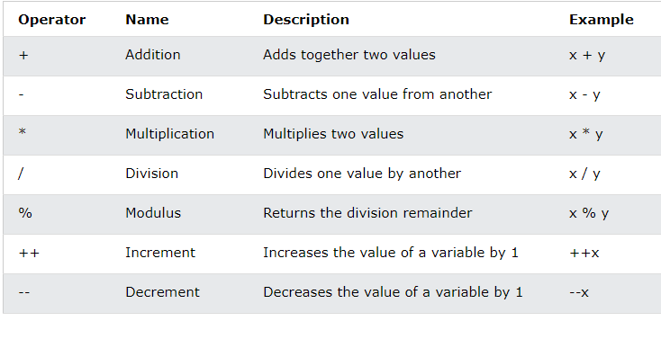
Arithmetic Operators Arithmetic operators are used to perform common mathematical operations.

Slide 19
Java Assignment Operators
Assignment operators are used to assign values to variables.
In the example below, we use the assignment operator (=) to assign the value 10 to a variable called x:
Example
int x = 10;
The addition assignment operator (+=) adds a value to a variable:
Example
int x = 10;
x += 5;

Slide 20
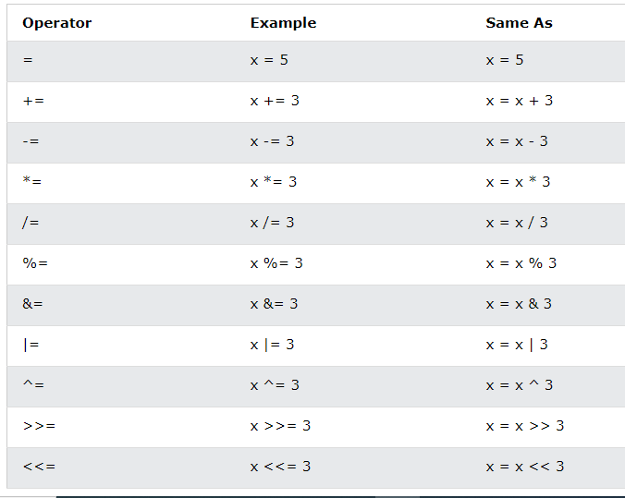

Slide 21
Java Comparison Operators
Comparison operators are used to compare two values (or variables). This is important in programming, because it helps us to find answers and make decisions.
The return value of a comparison is either true or false. These values are known as Boolean values.
In the following example, we use the greater than operator (>) to find out if 5 is greater than 3:
Example
int x = 5;
int y = 3;
System.out.println (x > y); // returns true, because 5 is higher than 3

Slide 22
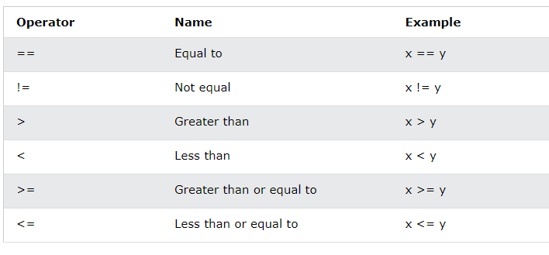
Java Comparison Operators

Slide 23
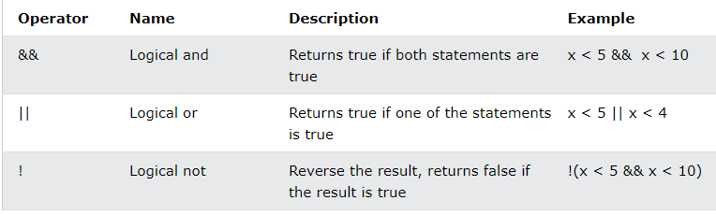
Java Logical Operators
You can also test for true or false values with logical operators.
Logical operators are used to determine the logic between variables or values:

